Slide 1
Write Your Own Functions I
Feitian College Summer Data Camp
July 13, 2019

Slide 2
Topics to be discussed
What are Functions?
Advantages of functions
How to define a Function?
Best Practices for Function Naming
Calling a Function
Parameters in Function
Passing by Reference versus Passing by Value
Function Arguments
Required Arguments
Keyword Arguments
Default Arguments
Variable Length Arguments

Slide 3
What are Functions?
A function is a block of organized, reusable code that is used to perform a single, related function.
Building block of computer programs – provides a level of abstraction
A function can be called whenever it is required.
Python gives many built-in function like print() which are called built-in functions.
User can also define his/her own functions which are called user-defined functions.

Slide 4
Advantages of Functions
By using function, one can avoid writing the same logic/code again and again in the same program.
We can call a function any number of times in a program and from any place in the program.
We can track a large program easily when it is divided into multiple functions.
Functions make the program more readable and understandable.

Slide 5
How to define a function?
Function block begins with a keyword def followed by a function name and parentheses( () ). For example,
def my_function():
Any input parameters or arguments should be placed within these parentheses. One can also define parameters within these parentheses.
The code block within every function starts with a colon (:) and is indented (best to have four spaces in front).
The first statement of a function can be an optional statement – the documentation string of function or docstring.
The statement “return [expression]” exits the function, passing back an expression to the caller. A return statement with no arguments is the same as “return None”.

Slide 6
Best Practices for Function Naming
Always name the function by the work it will do. For example, if the task of the function is to find sum of two numbers then name can be
def find_sum()
def calculate_sum()
Length of the name should not matter as long as the name of function clearly defines what the function is going to do.
I personally like to make the function name as short as possible
While still keeping it readable and understandable
One of the following ways can be used to name the function:
All lower case words separated by underscore (_). This is called Snake casing. For example,
def find_sum()
First word is lower case and the subsequent words will start with upper case letter. This is called Camel Casing. For example,
def findSum()

Slide 7
Syntax
def function_name(parameters):
“doc string”
<code block>
return [expression]
Note: By default the parameters have positional behavior and one needs to inform them in the same order that they were defined.
Example
def print_me( name ):
“This prints the passed string into this function”
print(name)
return

Slide 8
Calling a Function
Defining a function only gives it a name, specifies the parameters that are to be included in the function and structures the code of block.
Once the basic function is finalized, one can execute it by calling it from another function or directly from Python prompt.

Slide 9
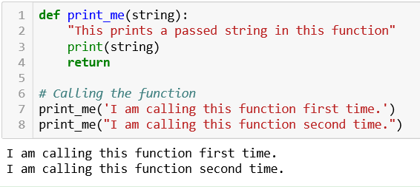
Example 1 - Calling a Function
In both line 7 and 8, the same function print_me is called. It can be called as many times as needed, so you don’t have to re-write the same code again and again.
Since the function does not return anything, no variable is instantiated or assigned.

Slide 10
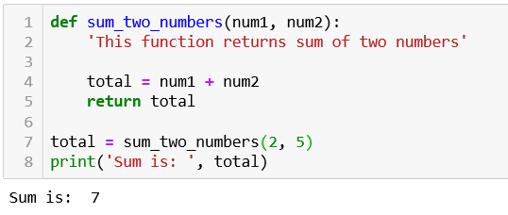
return Statement
The statement return [expression] exits a function, optionally passing back an expression to the caller.
A return statement with no arguments is the same as returning None.
Program which returns sum of two numbers
The function sum_two_numbers returns the total as seen in line 5.
As the function is returning some value so it need to be assigned to any variable after calling as shown in line 7.
The result is then printed in line 8.

Slide 11
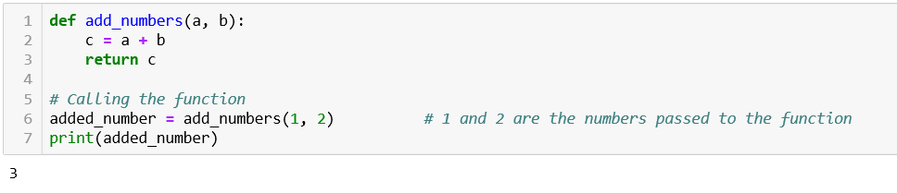
Example 2- Function returning a value.
In line 3, the function add_numbers returns the sum of two values (stored in variable c) to the caller.
So in line 6, the values returned by the function is assigned to the variable named added_number.
Line 7 prints the sum of two numbers.

Slide 12
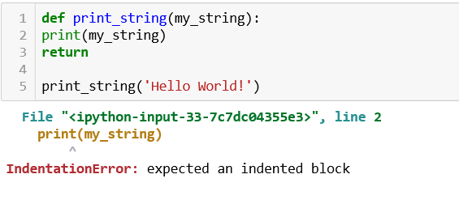
What Happens Without Indentation
In this example, we can see that the body of the function is not indented (which is line 2 and 3).
So the Python interpreter will give error message.

Slide 13
Parameters / arguments in Function
Information / input for a function can be passed as parameters (also called “arguments”).
The parameters are specified in the parentheses.
We can give any number of parameters, but they should be separated by comma (,).
In Example 2 discussed in the previous section, which finds the sum of two numbers, the function add_numbers take two parameters which are two numbers.

Slide 14
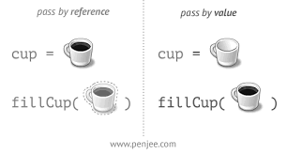
Passing by Reference v/s Passing by Value
All parameters (or arguments) in Python are passed by reference.
If one changes the parameter referred to within a function, the change is also reflected back in the calling function
Except in case of immutable objects like string, bool, unicode, tuple which can not be changed once created.

Slide 15
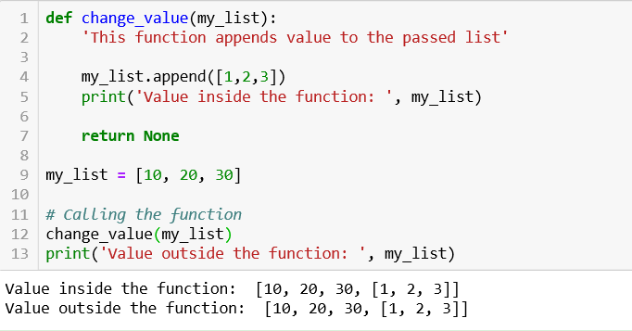
Example 1 – Object is Mutable
Program to append value to the list (defined outside the function) inside the function.
List named my_list has been defined in line 9.
In line 12, the change_value function has been called which appends value to my_list and prints the value in line 5.
The same list is also printed outside the function in line 13 which gives same result.
This means the change has been reflected back to the original list.

Slide 16
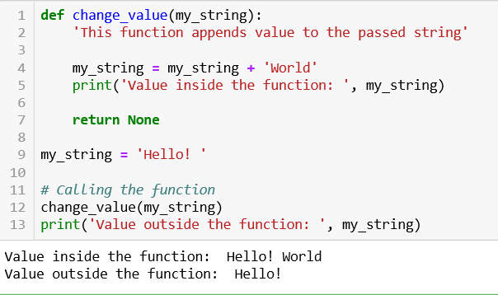
Example 2 – Object is Immutable
Program to append value to string which is defined outside the function.
Strings are Immutable which means their value can not be changed once assigned.
This is the reason that on adding the value to my_string in line 4 (inside the function), the original value does not change (which is outside the function).

Slide 17
Function Arguments
The following are various types of arguments which can be passed at the time of calling the function.
Required Arguments
Keyword Arguments
Default Arguments
Variable-length Arguments

Slide 18
1) Required Arguments
Required Arguments are the arguments passed to a function in correct positional order.
The number of arguments in the function call should exactly match with the function definition.
If either of the arguments is not provided in the function call, or the position of the arguments is changed, the Python interpreter will show the error.

Slide 19
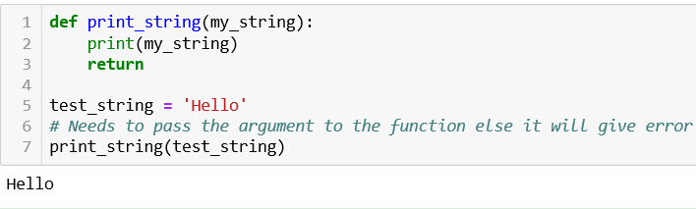
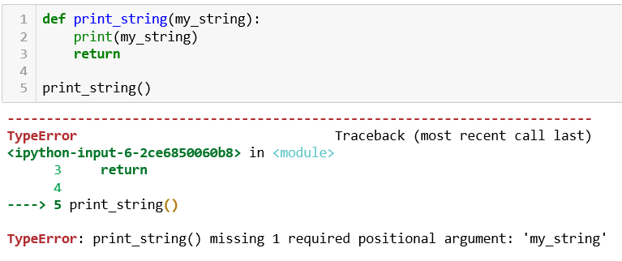
Example of Required Arguments
Program to print the string passed as an argument to the function.
String named test_string has been passed as an argument to the function print_string.
If we do not pass any argument to the function then it will give an error.
If no argument is passed to the function

Slide 20
2) Keyword Arguments
Keyword Arguments are related to the function call.
This type of function call enables us to pass the arguments in random order.
When we use keyword arguments in the function call, the caller identifies the arguments by the parameter name.
The name of the arguments is treated as the keywords and matched in the function calling and definition.
If the match is found, the values of the arguments are copied in the function definition.
This allows us to skip arguments or place them in random order because the Python interpreter is able to use the keywords provided to match the values with parameters.

Slide 21
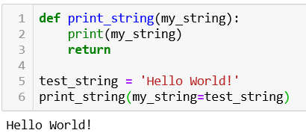
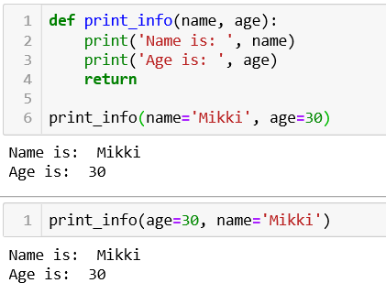
Example of Keyword Argument
Program to print string
Program to print name and age of person
In both these programs, whether it is one single argument or two, the position of the argument does not matter.
In the second example, we can see that whether we give the name first and age second, or age first and name second, the program produces same results.

Slide 22
3) Default Arguments
Python allows us to initialize the arguments at the function definition.
A default argument is an argument that assumes a default value if a value is not provided in the function call for that argument.
All default arguments should follow non-default arguments which means the default arguments should be specified after non-default arguments.
The value of default argument will get overwritten is new value is passed to it.

Slide 23
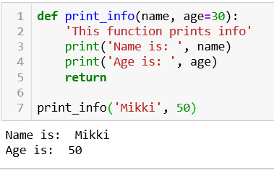
Example of Default Arguments
Program to print info
In the line 7, the function has been called with arguments values as ‘Mikki’ and 50.
The default value of age which is 30 will get overwritten by the new value passed to it which is 50.

Slide 24
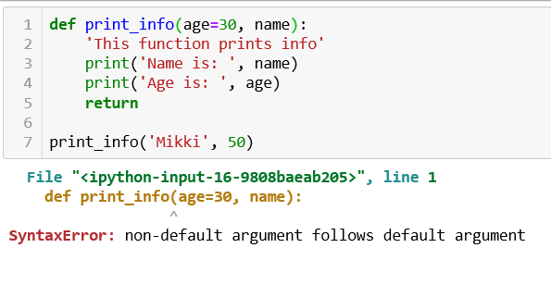
If non-default argument follows default argument
In this example, the default argument age has been defined first and the non-default argument later as seen in line 1.
This will give error message because default arguments should follow non-default arguments.

Slide 25
4) Variable Length Argument
In some cases, one needs to process a function for more arguments than specified while defining the function.
These arguments are called variable-length arguments.
Variable-length arguments are not named in the function definition like default or required arguments.
Python provides flexibility to provide the comma separated values at the function call.
At the function definition, we have to define the variable with *(star) like below
*<variable-name>
e.g. *name

Slide 26
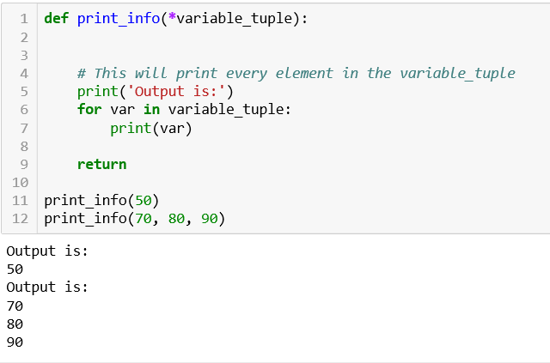
Example 1 of variable-length Argument
Program to print values passed
How this works?
In line 1, the parameter has been defined with *(star symbol) which tells Python that this parameter can be of variable length.
In line 6, every element of the passed tuple has been iterated using for loop.
In line 7, every iterated value has been printed which gets temporarily stored in variable named var.
In line 11 and 12, the function has been called with variable number of arguments.

Slide 27
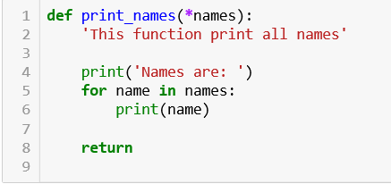
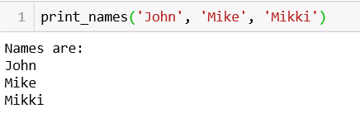
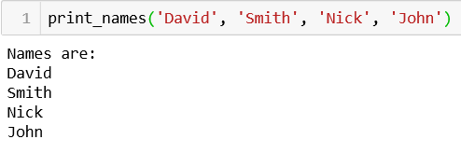
Example 2 of Variable-length Arguments
Program to print Names
The parameter in line 1 has been defined with *.
In the output part, we can see that whether we give 3 values or 4, the function is printing all values.
This is the advantage of Variable-length Arguments.
Output

Slide 28
Practice Questions
Write a Python function to find max of two numbers. Pass the two numbers as Required Arguments to the function.
Write a Python function to sum all the elements of any number of lists. Pass any number of lists to the function. (Hint: Use Variable length Argument Passing).
Write a Python function to check if a given number is even or not. Use a keyword parameter called ‘num’, whose default value is 2.
Write a Python function which takes a list and returns a new list with only the unique elements of the input list.

Slide 29
Continue…
Write a Python Function which takes a list as parameter and prints all the even numbers in the list.
Write a Python function which takes length and breadth as input and prints the area and perimeter of Rectangle. Take the default value of breadth as 10 units.
Write a function to tell user if he/she is able to cast a vote or not. (Considering minimum age of voting to be 18). The function takes age of person as parameter.
Write a Python Function to find the power of a number raised to other e.g. ab . Take the default value of b as 1. The function takes a and b as parameters to it.

Slide 30
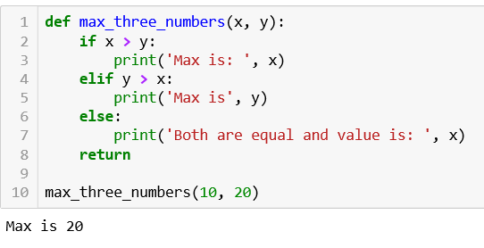
Solutions
Note: There can be more than one solutions to the same problem.
Solution 1
How this works?
From line 1 to 8, we have created a function which takes two Required arguments.
In line 10, the function has been called by passing two required arguments whose values are 10 and 20.
During function call, the 10 values get assigned to variable x and 20 value get assigned to variable y based upon their positions.
And the function computes the max of two numbers using conditional statements.

Slide 31
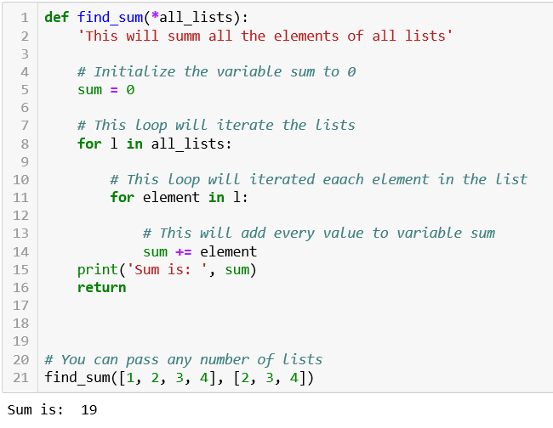
Solution 2
How this works?
The function find_sum takes a variable-length argument named all_lists.
In line 5, a variable named sum has been initialized with 0 which will store sum of all elements.
In line 8, the for loop iterates over each list present in the all_lists.
In line 11, the for loop iterates over each element present in the list l. This is nested looping.
In line 14, every element has been added to variable sum.
Line 15 prints the Sum of all elements.
Note: You can pass any number of lists while calling in line 21.

Slide 32
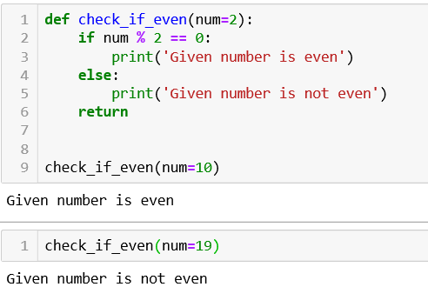
Solution 3:
The function check_if_even takes default argument num initialized to 2.
Line 2 check if the remainder is 0. If so then line 3 is executed which prints that the number is even.
Else line 5 gets executed which prints number is not even.
In line 9, the function has been called with passing the value of num as 10. So the function prints it as even.
The same function is called again with value 19 and it prints the number is not even.

Slide 33
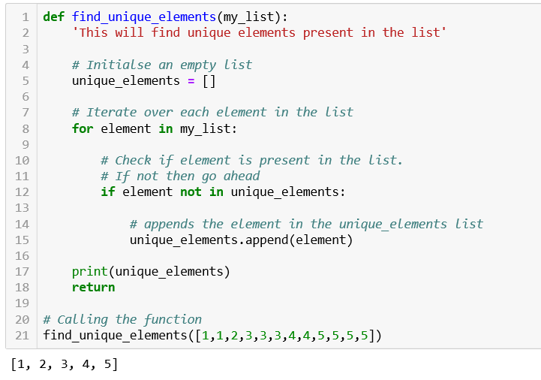
In line 1, the function definition starts which takes my_list as parameter.
Line 5 initializes an empty list which will store all the unique elements present in the my_list.
Line 8 iterates over each element in the list.
Line 12 checks if the element not contained in the unique_elements.
If it is not contained then line 15 will append that element into unique_elements.
Line 17 prints all the unique elements.
Line 21 calls the function.
Solution 4:

Slide 34
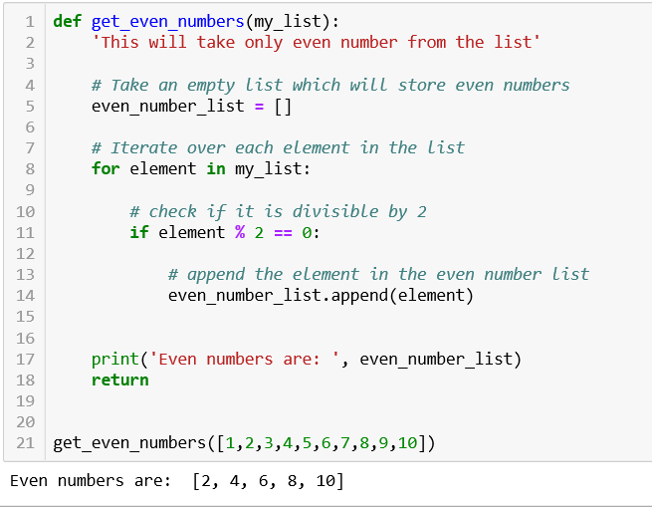
Solution 5:
The function for finding the even numbers has been defined at line 1 and has been called at line 21.
During calling at line 21, the function has been passed a list of integers having both even and odd numbers.
In line 5, an empty list has been created which will store all the even numbers.
In line 8, for loop iterates over each element in the list.
Line 11 checks if the element is divisible by 2.
If so then in line 14, that element will get appended to even number list.
Line 17 prints all even numbers stored in even_number_list.

Slide 35
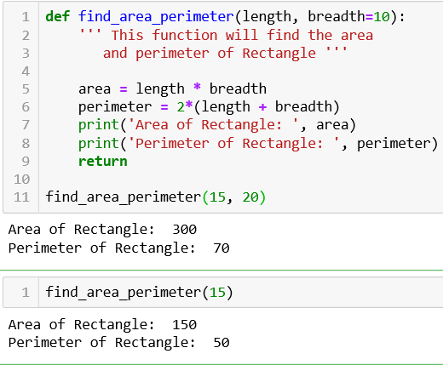
Solution 6:
Two arguments has been passed to the find_area_perimeter function.
One is default argument and other is non-default argument.
As you can see in line 1, the default argument follows the non-default argument.
This is important to remember else the Python interpreter will produce error.
So even if we give only one parameter to the function e.g. 15, the function will take the default value of breadth and will compute the results.

Slide 36
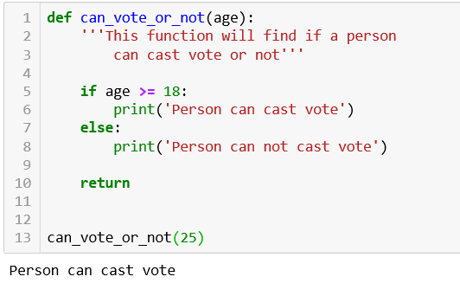
Solution 7:
The function takes age as parameter.
In line 5, it checks whether the provided age is greater than or equal to 18.
If so then line 6 will get executed else line 8 will get executed.

Slide 37
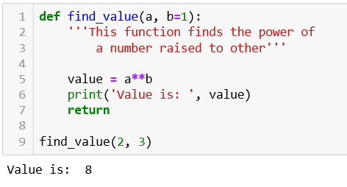
Solution 8:
The function takes two arguments. One is default and other is non-default.
Default argument follows the non-default argument.
**(double star) between two number will find the power of first raised to second.

